Slide 1
Georgia Traffic Prediction
By: Cody Srey

Slide 2

Overview/Purpose
The script is running on Python which was designed for traffic predictions on most of the main roads in Georgia.
It combines deep learning and traditional machine learning approaches, making it versatile for various analysis applications.
The script runs from historical data which makes informed decisions making for traffic management and infrastructure planning.

Slide 3
Imports/Prerequisite
Numpy: Provides support for arrays, matrices, and math functions
Pandas: Provides data structures to handle and analyze the data
Matplotlib: Creates the visualization and plotting data
Tensorflow: Imports Sequential to add layers to create a neural network
Dense: Connected layer used
Scikit-learn: MinMaxScaler scales features to given range
StandardScaler: Makes features by removing the mean and scale to the unit variance
Math Absolute Error & Mean Squared Error: Used in the regression evaluation
Confusion Matrix & Classification Report: Used in classification evaluation
Simple Imputer: Handled the missing values that are in my datasets(Replaced NaNs with 0s)

Slide 4
Dataset That was Used
Georgia Department of Transportation:
Station ID
Functional Class: Grouping roads based on their intended uses
Simpler Terms: Is the location Urban or Rural
Location’s Latitude and Longitude
AADT_2023 -2014: The Annual Average Daily Traffic of 23-14
Truck%_2023 – 2014: What is the Truck Percentage of 23 - 14

Slide 5
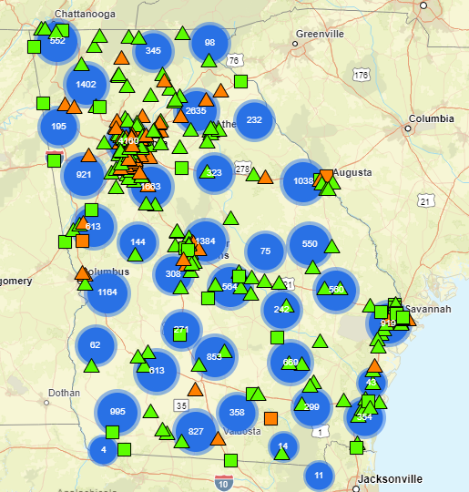
Georgia Map
Triangles:
- Green: Continuous Count Station
Counts Traffic 24/7
- Orange: Inactive CCS
Squares:
- Green: Weigh in Motion
Collects traffic and data weight all year round
- Orange: Inactive CCS
Circles:
- Blue: Short Term Active
Temporary station that typically collects traffic data
in a 48-hour period.

Slide 6
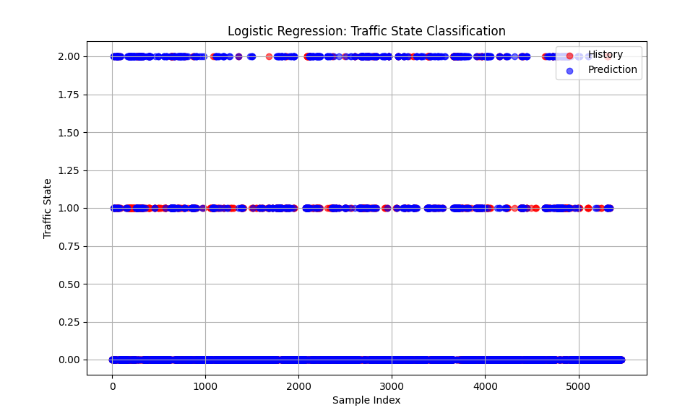
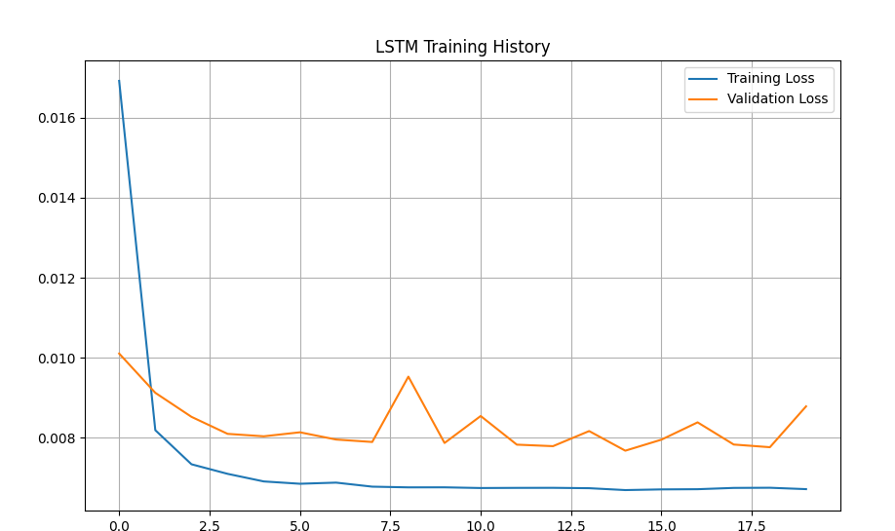
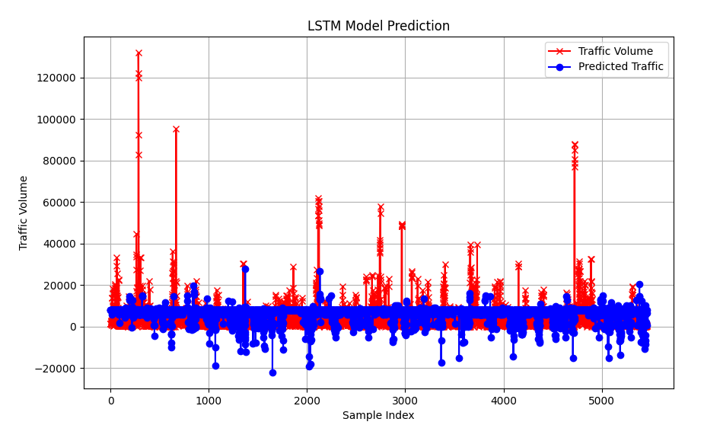
Graphs
Logistic Regression: An algorithm that analyze the relationship between two data factors
LSTM History: Shows the training process during the epochs. Shows the training loss and validation loss.
Long Short-Term Memory Model: Stores and processes information over multiple times

Slide 7
Outputs
- Classification Report:
Precision: The ratio of true positive predictions to the total predicted positives
Recall: The ratio of true positive predictions to the total actual positives
F1-Score: The mean of precision and recall and provides a balance between the two.
Support: The number of actual occurrences of each class in the specified dataset
- Confusion Matrix: Evaluates the performance of the classification model. - Mean Absolute Error(MAE): Measures the average magnitude of errors in the prediction
- Root Mean Square Error(RMSE): Measures the average magnitude as well but has a higher weight to the error because it squares the errors before get the average

